Slide 1
Computer Aided Engineering Design
Anupam Saxena
Associate Professor
Indian Institute of Technology KANPUR 208016

Slide 2
# 4 Can Solids be generalized?
Notes:
The main question that the INQUISITIVE MIND ASKED in the previous lecture WAS…
<READ>
THAT IS, CAN WE COME UP WITH A SINGLE STATEMENT THAT COVERS VALID SOLIDS OF ALL POSSIBLE SHAPES AND SIZES?

Slide 3
Why topology?
description of solids is quite broad
with geometry, the form (shape and size) of a solid is precisely laid
boundary determinism suggests that only the closed connected surface b(V) would seem sufficient to represent a solid in E³
endeavor is to use a representation scheme that generically and efficiently models a solid of any form
One way is to ignore lengths and angles and study for the notations of continuity, connectivity and closeness, i.e. study the topology of the solid
Geometric/PARAMETRIC Modeling
Solid Modeling
Perception of Solids
Modeling of Curves
Modeling of Surfaces (Patches)
Topology and Solids
Solid Modeling 1-2
Transformations and Projections 1-2
Representation, Differential Geometry
Ferguson Segments
Bezier Segments 1-2
B-spline curves 1-5
NURBS
Differential Geometry
Tensor Product
Boundary Interpolating
Composite
NURBS
Notes:
Q: Why do we need to study TOPOLOGY?
<READ> Paraphrase…
They are plentiful, AND COME IN A variety of shapes!
<READ> Paraphrase…
Geometry does not give us the flexibility for generalization!
<READ> Paraphrase…
Looks like only bounding surfaces need to be considered!
<READ> Paraphrase…
<READ> Paraphrase…
With topology, one lets go of the SPECIFICITY in size and shape and discusses only CONNECTIVITY
We will try to answer if it is possible to describe solids generically!

Slide 4
What is topology ?
Geometric/PARAMETRIC Modeling
Solid Modeling
Perception of Solids
Modeling of Curves
Modeling of Surfaces (Patches)
Topology and Solids
Solid Modeling 1-2
Transformations and Projections 1-2
Representation, Differential Geometry
Ferguson Segments
Bezier Segments 1-2
B-spline curves 1-5
NURBS
Differential Geometry
Tensor Product
Boundary Interpolating
Composite
NURBS
Topology studies the patterns in geometric figures for relative positions without regard to size
Topology is sometimes referred to as the rubber sheet geometry
bending, twisting, stretching and other such transformations are allowed
cutting, tearing and gluing operations are NOT allowed
Notes:
The next question is ---- What is TOPOLOGY?
<READ> Paraphrase…
In essence, topology studies connectivity and the associated properties…
<READ> Paraphrase…
Example, if we consider a rubber band ---- one can give any shape to it, but in essence, it is a LOOP…
When studying TOPOLOGICAL PROPERTIES, bending, twisting … <SLIDE>
<READ> Paraphrase…
Example 1: A Tennis BALL… <Camera>
Example 2: A paper loop … <Camera>

Slide 5
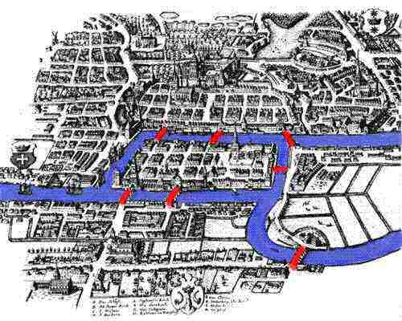
analysis situs
topology was initiated by Euler
Solution to the Königsberg bridge problem
determine if the seven bridges (edges) in the city of Königsberg across four land patches (nodes) can all be traversed in a single trip without doubling any bridge back
Answer was NO
Geometric/PARAMETRIC Modeling
Solid Modeling
Perception of Solids
Modeling of Curves
Modeling of Surfaces (Patches)
Topology and Solids
Solid Modeling 1-2
Transformations and Projections 1-2
Representation, Differential Geometry
Ferguson Segments
Bezier Segments 1-2
B-spline curves 1-5
NURBS
Differential Geometry
Tensor Product
Boundary Interpolating
Composite
NURBS
3
1
2
4
7
6
5
seas.gwu.edu
Notes:
Topology or ‘Analysis situs’ --- situs --- refers to “site” perhaps --- Was initiated by Euler
Euler was challenged if he could solve the Konigsberg bridge problem…
<READ THE PROBLEM>
Bridges are demarcated by the RED curves on the left
In this figure (right), nodes are four islands, and the seven curves represent the respective bridges…
Euler answered in NO!

Slide 6
Homeomorphism
Two solids belong to the same topological class if they have the same basic, overall structure even though differing much in details
Geometric/PARAMETRIC Modeling
Solid Modeling
Perception of Solids
Modeling of Curves
Modeling of Surfaces (Patches)
Topology and Solids
Solid Modeling 1-2
Transformations and Projections 1-2
Representation, Differential Geometry
Ferguson Segments
Bezier Segments 1-2
B-spline curves 1-5
NURBS
Differential Geometry
Tensor Product
Boundary Interpolating
Composite
NURBS
b
a
a
a
c
Notes:
<READ TITLE>
This is one of the topological properties that solids SHARE…
Loose meaning of Homeomorphic is ---- “of the same shape”
<READ THE FIRST STATEMENT>
<PARAPHRASE THE EXAMPLE>

Slide 7
Homeomorphism
Geometric/PARAMETRIC Modeling
Solid Modeling
Perception of Solids
Modeling of Curves
Modeling of Surfaces (Patches)
Topology and Solids
Solid Modeling 1-2
Transformations and Projections 1-2
Representation, Differential Geometry
Ferguson Segments
Bezier Segments 1-2
B-spline curves 1-5
NURBS
Differential Geometry
Tensor Product
Boundary Interpolating
Composite
NURBS
P
P
P
homeomorphic
Sense of orientation about P is maintained
P
Non-homeomorphic
Sense of orientation about P is lost
Notes:
Further on Homeomorphism, let’s look at how polylines or polygons fare
<DISCUSS the EXAMPLE…>

Slide 8
Topology of Surfaces
Surfaces are compact and connected topological objects
each point has a neighborhood (all the points on the surface within a closed curve around the point)
A neighborhood is homeomorphic to either a plane (R²) or a half plane (H²)
Geometric/PARAMETRIC Modeling
Solid Modeling
Perception of Solids
Modeling of Curves
Modeling of Surfaces (Patches)
Topology and Solids
Solid Modeling 1-2
Transformations and Projections 1-2
Representation, Differential Geometry
Ferguson Segments
Bezier Segments 1-2
B-spline curves 1-5
NURBS
Differential Geometry
Tensor Product
Boundary Interpolating
Composite
NURBS
Q
P
R
P: interior point Q, R: boundary points
Notes:
We mentioned ibefore that the bounding surfaces are adequate enough to represent the respective solids!
Let’s see what surfaces are from a topological perspective
<READ>
<after figure>
--- for point P, the neighborhood is a full plane. These can be infinitely stretched into 2 D planes.
--- for Q and R, the neighborhoods are half planes --- when infinitely stretched, they only constitute “conceptually” a ½ 2D plane.

Slide 9
Surfaces and Boundaries
A closed surface is one having no boundary
Geometric/PARAMETRIC Modeling
Solid Modeling
Perception of Solids
Modeling of Curves
Modeling of Surfaces (Patches)
Topology and Solids
Solid Modeling 1-2
Transformations and Projections 1-2
Representation, Differential Geometry
Ferguson Segments
Bezier Segments 1-2
B-spline curves 1-5
NURBS
Differential Geometry
Tensor Product
Boundary Interpolating
Composite
NURBS
a
a
Surfaces with NO boundary
hemisphere
disk
Surface with ONE
boundary
Surface with
TWO boundaries
Surface with
ONE boundary
Notes:
<Read and Explain>

Slide 10
Boundaries of this Surface?
Geometric/PARAMETRIC Modeling
Solid Modeling
Perception of Solids
Modeling of Curves
Modeling of Surfaces (Patches)
Topology and Solids
Solid Modeling 1-2
Transformations and Projections 1-2
Representation, Differential Geometry
Ferguson Segments
Bezier Segments 1-2
B-spline curves 1-5
NURBS
Differential Geometry
Tensor Product
Boundary Interpolating
Composite
NURBS
Notes:
<POSE the QUESTION>
Yes! IT is 2!!!
Boundaries are like closed contours, BOTH INTERIOR and EXTERIOR!!!
Question: Can a surface with boundaries ENCLOSE a volume to represent the bounding surface of a solid?
The answer is NO as o now, but you can perform certain “CLOSING UP OPERATIONS!”

Slide 11
Closed-up surfaces
Q
Geometric/PARAMETRIC Modeling
Solid Modeling
Perception of Solids
Modeling of Curves
Modeling of Surfaces (Patches)
Topology and Solids
Solid Modeling 1-2
Transformations and Projections 1-2
Representation, Differential Geometry
Ferguson Segments
Bezier Segments 1-2
B-spline curves 1-5
NURBS
Differential Geometry
Tensor Product
Boundary Interpolating
Composite
NURBS
P
R
A generic surface is composed of boundary components
Each boundary is homeomorphic to a circle
If a disc is attached to ALL boundary components, the result will be a closed up surface
This closing-up operation preserves homeomorphism types
If S₁≈ S₂, Ŝ₁≈ Ŝ₂:
if two surfaces are homeomorphic, their closed up results will be homeomorphic as well!
Notes:
<READ and Explain!>
<After 3rd LINE>
This is like eliminating the boundaries ONE BY ONE…
A closed up surface will be one with NO boundaries…
It will behave like the bounding surface of a solid!
<After the line, IF S1 HOMEOMORPHICTO S2, >
S_cap refers to the closed up surface corresponding to S!

Slide 12
Connected sum
Given Ŝ₁ and Ŝ₂ as two closed surfaces, one can cut out a disc from each one and attach the resultants along their cut boundaries
result is a closed surface Ŝ₁ # Ŝ₂ called the connected sum of two surfaces
Geometric/PARAMETRIC Modeling
Solid Modeling
Perception of Solids
Modeling of Curves
Modeling of Surfaces (Patches)
Topology and Solids
Solid Modeling 1-2
Transformations and Projections 1-2
Representation, Differential Geometry
Ferguson Segments
Bezier Segments 1-2
B-spline curves 1-5
NURBS
Differential Geometry
Tensor Product
Boundary Interpolating
Composite
NURBS
∪
=
Notes:
We can extend this concept into that of a “Connected Sum”
<Read and Explain the example!>
Questions:
Would the result have any boundaries?
- Can this result behave as the bounding surface for a solid?

Slide 13
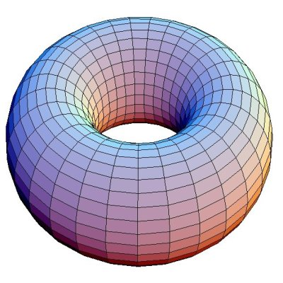
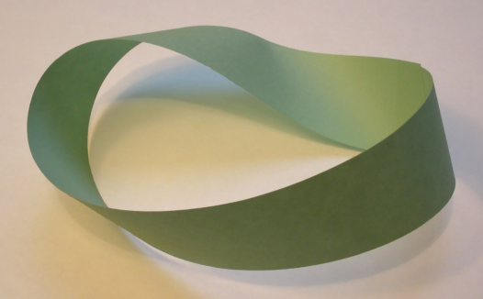
Some basic surfaces & classification
sphere and torus: some examples of basic closed surfaces
Geometric/PARAMETRIC Modeling
Solid Modeling
Perception of Solids
Modeling of Curves
Modeling of Surfaces (Patches)
Topology and Solids
Solid Modeling 1-2
Transformations and Projections 1-2
Representation, Differential Geometry
Ferguson Segments
Bezier Segments 1-2
B-spline curves 1-5
NURBS
Differential Geometry
Tensor Product
Boundary Interpolating
Composite
NURBS
Construction of a torus
Construction of a Möbius strip
http://mcraefamily.com/MathHelp/BasicSetTopologyKidsIntro.htm
math.harvard.edu
revdhj.wordpress.com
Notes:
Let us now study some basic surfaces and try to classify them!
Basic surfaces are of four types: SPHERE, TORUS, Mobius strip and Cross Cap!
<Explain construction of a torus>
<Explain Construction of a Mobius strip>
<USE PAPER STRIP>

Slide 14
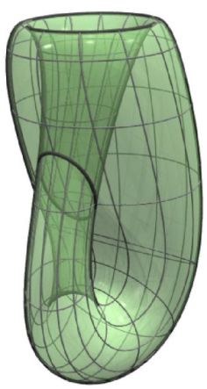
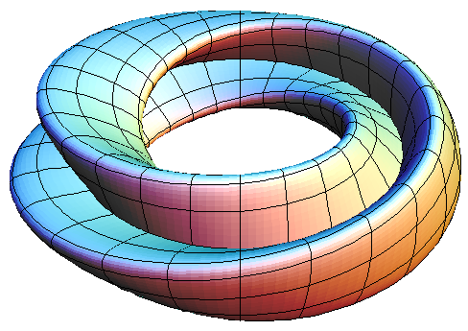
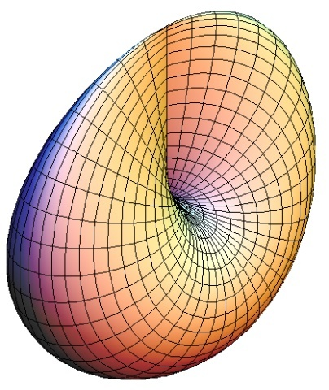
Some basic surfaces & classification
Geometric/PARAMETRIC Modeling
Solid Modeling
Perception of Solids
Modeling of Curves
Modeling of Surfaces (Patches)
Topology and Solids
Solid Modeling 1-2
Transformations and Projections 1-2
Representation, Differential Geometry
Ferguson Segments
Bezier Segments 1-2
B-spline curves 1-5
NURBS
Differential Geometry
Tensor Product
Boundary Interpolating
Composite
NURBS
Construction of a Klein bottle/Figure 8 projection
Cannot be constructed in 3d without self intersection
Construction of a cross cap
Cannot be constructed in 3d without self intersection
muchgrace.com
lancs.ac.uk
virtualmathmuseum.org
Notes:
The arrows show the relative alignment of the opposite edges when they are to be attached!
<Explain construction of a Klein bottle>
<Explain construction of a crosscap>

Slide 15
Main classification theorem for Surfaces
every closed surface is homeomorphic to a sphere with some handles* or crosscaps attached
every single surface is one of the following:
(a) A sphere,
(b) a connected sum of tori or
(c) a connected sum of cross caps
* A torus is homeomorphic to a coffee mug with a handle
Geometric/PARAMETRIC Modeling
Solid Modeling
Perception of Solids
Modeling of Curves
Modeling of Surfaces (Patches)
Topology and Solids
Solid Modeling 1-2
Transformations and Projections 1-2
Representation, Differential Geometry
Ferguson Segments
Bezier Segments 1-2
B-spline curves 1-5
NURBS
Differential Geometry
Tensor Product
Boundary Interpolating
Composite
NURBS
Notes:
<READ>
We are interested in 3D solids --- So for us, every single bounding surface is either a sphere or a connected sum of tori ---
If any Solid modeler can address this classification, it can model ANY SOLID.

Slide 16
Torus and a coffee mug
Geometric/PARAMETRIC Modeling
Solid Modeling
Perception of Solids
Modeling of Curves
Modeling of Surfaces (Patches)
Topology and Solids
Solid Modeling 1-2
Transformations and Projections 1-2
Representation, Differential Geometry
Ferguson Segments
Bezier Segments 1-2
B-spline curves 1-5
NURBS
Differential Geometry
Tensor Product
Boundary Interpolating
Composite
NURBS
http://mcraefamily.com/MathHelp/BasicSetTopologyKidsIntro.htm
Notes:
<Show this>

Slide 17
# 5 Invariants and Homeomorphism
Notes:
The main question that the INQUISITIVE MIND ASKED in the previous lecture WAS…
<READ>
THAT IS, CAN WE COME UP WITH A SINGLE STATEMENT THAT COVERS VALID SOLIDS OF ALL POSSIBLE SHAPES AND SIZES?

Slide 18
Invariants of Surfaces
Certain properties remain invariant under homeomorphic transformations
number of boundary components
Orientability
Genus
Euler characteristic
Connectivity number of a surface
Geometric/PARAMETRIC Modeling
Solid Modeling
Perception of Solids
Modeling of Curves
Modeling of Surfaces (Patches)
Topology and Solids
Solid Modeling 1-2
Transformations and Projections 1-2
Representation, Differential Geometry
Ferguson Segments
Bezier Segments 1-2
B-spline curves 1-5
NURBS
Differential Geometry
Tensor Product
Boundary Interpolating
Composite
NURBS
Notes:
<READ> paraphrase…
Let’s take these properties one by one…

Slide 19
Number of boundary components
represented by an integer c.
for a sphere or a torus, c = 0
for a disc or a hemisphere c = 1
for an open-ended cylinder c = 2
Geometric/PARAMETRIC Modeling
Solid Modeling
Perception of Solids
Modeling of Curves
Modeling of Surfaces (Patches)
Topology and Solids
Solid Modeling 1-2
Transformations and Projections 1-2
Representation, Differential Geometry
Ferguson Segments
Bezier Segments 1-2
B-spline curves 1-5
NURBS
Differential Geometry
Tensor Product
Boundary Interpolating
Composite
NURBS
Notes:
<Read paraphrase>
<Explain with examples>
<TURN TO THE EXAMPLE…>

Slide 20
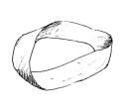
Orientability
Geometric/PARAMETRIC Modeling
Solid Modeling
Perception of Solids
Modeling of Curves
Modeling of Surfaces (Patches)
Topology and Solids
Solid Modeling 1-2
Transformations and Projections 1-2
Representation, Differential Geometry
Ferguson Segments
Bezier Segments 1-2
B-spline curves 1-5
NURBS
Differential Geometry
Tensor Product
Boundary Interpolating
Composite
NURBS
n
Q
Q
C
orientable
Non-orientable
Represented by ∈ such that ∈ = 1 for all orientable surfaces
while 0 for the non-orientable ones
Notes:
<Explain> Impromptu… a sphere and a mobius strip…
EARTH, AROUND THE WORLD IN 80 DAYS, OR 8 DOLLARS…
TENNIS BALL, OR A SOCCER BALL
<EXPLAIN WITH PHYSICAL EXAMPLES…>
- MOBIUS STRIP… BIG ONE!
NOTE THAT THIS SHULD BE TRUE FOR ALL POINTS ON THE SURFACE AND FOR ALL PATHS…
JOKE ABOUT THE MOBIUS STRIP! PASSING “Q” WHILE CROSSING IT THE FIRST TIME AND THEN GETTING THE SAME ORIENTATION THE NEXT TIME YOU STEP ON IT…

Slide 21
Genus
- an integer g that is
the number of handles for closed orientable surfaces (∈ = 1)
the number of crosscaps for closed non-orientable surfaces (∈ = 0)
Geometric/PARAMETRIC Modeling
Solid Modeling
Perception of Solids
Modeling of Curves
Modeling of Surfaces (Patches)
Topology and Solids
Solid Modeling 1-2
Transformations and Projections 1-2
Representation, Differential Geometry
Ferguson Segments
Bezier Segments 1-2
B-spline curves 1-5
NURBS
Differential Geometry
Tensor Product
Boundary Interpolating
Composite
NURBS
g = 2
g = 1
Notes:
<Read> paraphrase… Explain…
<AFTER THE SECOND LINE>
IF YOU RECALL FROM THE PREVIOUS LECTURE, A TORUS IS LIKE A COFFEE MUG WITH A HANDLE
<AFTER THE THIRD LINE>
- WE DO NOT CONSIDER CROSS CAPS TO BE GETTING FORMED IN OUR MODELS…

Slide 22
Genus value?
Geometric/PARAMETRIC Modeling
Solid Modeling
Perception of Solids
Modeling of Curves
Modeling of Surfaces (Patches)
Topology and Solids
Solid Modeling 1-2
Transformations and Projections 1-2
Representation, Differential Geometry
Ferguson Segments
Bezier Segments 1-2
B-spline curves 1-5
NURBS
Differential Geometry
Tensor Product
Boundary Interpolating
Composite
NURBS
g = 5
Notes:
Explain the figure, first …
Five blocs, each with a through hole…
Each one is homeomorphic to a torus!
The blocks are Glued together such that only a part of a face is shared by the contiguous block!
WAIT…
G = 5!
Why? The solid is like the “CONNECTED SUM” of FIVE TORI..

Slide 23
Euler characteristic χ
for polyhedrons:
χ = v – e + f
v is the number of vertices
e is the number of edges and
f is the number of faces
Geometric/PARAMETRIC Modeling
Solid Modeling
Perception of Solids
Modeling of Curves
Modeling of Surfaces (Patches)
Topology and Solids
Solid Modeling 1-2
Transformations and Projections 1-2
Representation, Differential Geometry
Ferguson Segments
Bezier Segments 1-2
B-spline curves 1-5
NURBS
Differential Geometry
Tensor Product
Boundary Interpolating
Composite
NURBS
b
a
a
c
a
χ = 8 – 12 + 6 = 2
Notes:
THIS IS AN IMPORTANT ONE… <READ TITLE>
<Read> paraphrase… Explain…
ALL THE THREE SOLIDS ARE DIFFERENT “ HOMEOMORPHIC“ VERSIONS OF A CUBE!
THE RELATION IS VALID FOR ALL POLYHEDRA HOMEOMORPHIC TO A SPHERE!

Slide 24
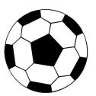
Euler characteristic χ
Geometric/PARAMETRIC Modeling
Solid Modeling
Perception of Solids
Modeling of Curves
Modeling of Surfaces (Patches)
Topology and Solids
Solid Modeling 1-2
Transformations and Projections 1-2
Representation, Differential Geometry
Ferguson Segments
Bezier Segments 1-2
B-spline curves 1-5
NURBS
Differential Geometry
Tensor Product
Boundary Interpolating
Composite
NURBS
for a tetrahedron
For a soccer ball
For surfaces
χ = 4 – 6 + 4 = 2
χ = 60 – 90 + 32 = 2
χ = 2 – 2g – c if ∈ = 1
and χ = 2 – g – c if ∈ = 0
For a sphere, χ for a sphere with genus 0 and no boundary
is 2
A sphere is homeomorphic to all figures in the previous slide
Notes:
Let’s first test this result and then later, try to prove it!
WE WILL PRESENT THE PROOFS FOR BOTH POLYHEDRA WITHOUT AND WITH HOLES…
<Read> paraphrase… Explain…

Slide 25
Proof of the Euler Characteristic
Pictorial “DIVIDE AND CONQUER” proof using a cube
True for any polyhedron homeomorphic to a sphere
Geometric/PARAMETRIC Modeling
Solid Modeling
Perception of Solids
Modeling of Curves
Modeling of Surfaces (Patches)
Topology and Solids
Solid Modeling 1-2
Transformations and Projections 1-2
Representation, Differential Geometry
Ferguson Segments
Bezier Segments 1-2
B-spline curves 1-5
NURBS
Differential Geometry
Tensor Product
Boundary Interpolating
Composite
NURBS
χ = v – e + f = 8 – 12 + 6 = 2
Take the top face off!
χ = v – e + f = 8 – 12 + 5 = 1
The remnant is homeomorphic to a disc!
Lay it flat on a plane to get a
PLANAR GRAPH!

Slide 26
Proof of the Euler Characteristic
χ = v – e + f = 8 – 12 + 5 = 1
Geometric/PARAMETRIC Modeling
Solid Modeling
Perception of Solids
Modeling of Curves
Modeling of Surfaces (Patches)
Topology and Solids
Solid Modeling 1-2
Transformations and Projections 1-2
Representation, Differential Geometry
Ferguson Segments
Bezier Segments 1-2
B-spline curves 1-5
NURBS
Differential Geometry
Tensor Product
Boundary Interpolating
Composite
NURBS
χ = v – e + f = 8 – 12 (+1) + 5 (+1) = 1
If I add an edge…
Once done, we get a bunch of
Triangles!
Keep adding these diagonal
edges…

Slide 27
Proof of the Euler Characteristic
χ = v – e + f = 8 – 12 + 5 = 1
Geometric/PARAMETRIC Modeling
Solid Modeling
Perception of Solids
Modeling of Curves
Modeling of Surfaces (Patches)
Topology and Solids
Solid Modeling 1-2
Transformations and Projections 1-2
Representation, Differential Geometry
Ferguson Segments
Bezier Segments 1-2
B-spline curves 1-5
NURBS
Differential Geometry
Tensor Product
Boundary Interpolating
Composite
NURBS
χ = v – e + f = 8 – 12 (+1) + 5 (+1) = 1
χ = v – e + f = 8 – 12 (+5) + 5 (+5) = 1
If I add an edge…
Once done, we get a bunch of
Triangles!
Keep adding these diagonal
edges…

Slide 28
Proof of the Euler Characteristic
Geometric/PARAMETRIC Modeling
Solid Modeling
Perception of Solids
Modeling of Curves
Modeling of Surfaces (Patches)
Topology and Solids
Solid Modeling 1-2
Transformations and Projections 1-2
Representation, Differential Geometry
Ferguson Segments
Bezier Segments 1-2
B-spline curves 1-5
NURBS
Differential Geometry
Tensor Product
Boundary Interpolating
Composite
NURBS
χ = v – e + f = 1
Carefully Remove the edges/vertices one by one!
Ensure that v – e + f = 1 is retained!
χ = v – e + f = 1
χ = v – e + f = 1
χ = v – e + f = 1
χ = v – e + f = 1
χ = v – e + f = 3 – 3 + 1 = 1

Slide 29
Euler characteristic - solids with handles
Geometric/PARAMETRIC Modeling
Solid Modeling
Perception of Solids
Modeling of Curves
Modeling of Surfaces (Patches)
Topology and Solids
Solid Modeling 1-2
Transformations and Projections 1-2
Representation, Differential Geometry
Ferguson Segments
Bezier Segments 1-2
B-spline curves 1-5
NURBS
Differential Geometry
Tensor Product
Boundary Interpolating
Composite
NURBS
χ = v – e + f = 2
χ = v – e + f = 2
χ = v – e + f = 2 – 1 = 1
χ = v – e + f = 2 – 2 = 0
χ = 2 – c
χ = 2 – c
c is the number of
boundaries
χ = 2 – 2g – c
χ = v – e + f
- Three new faces appear
- Boundary components disappear
Δχ = Δv – Δe + Δf
Δχ = 0 – 3 + 1 = –2
- Three new edges appear
- Two faces from previous tessellation disppear
χ(g=1) – χ(s) = –2 ⇒ χ(g) = 2 – 2 = 0
χ(g) = 2 – 2g
χ(g, c) = 2 – 2g – c

Slide 30
Connectivity number of a surface
The number of cuts* PLUS 1 made on a surface without separating it into two or more parts.
For closed surfaces,
the connectivity number is 3 – χ
for a surface with boundaries,
the connectivity number is 2 – χ
A surface with connectivity number 1, 2 or 3 is termed simply, doubly or triply connected respectively.
A sphere is simply connected
a torus is triply connected.
First cut: cylinder
Second cut: plane
Third cut: two planes
*closed cuts, or cuts connecting points on boundaries or on previous cuts
Geometric/PARAMETRIC Modeling
Solid Modeling
Perception of Solids
Modeling of Curves
Modeling of Surfaces (Patches)
Topology and Solids
Solid Modeling 1-2
Transformations and Projections 1-2
Representation, Differential Geometry
Ferguson Segments
Bezier Segments 1-2
B-spline curves 1-5
NURBS
Differential Geometry
Tensor Product
Boundary Interpolating
Composite
NURBS
Notes:
<Read> paraphrase… Explain…
Explain with examples…!

Slide 31
Manifolds
local shapes describing the local topology of geometric entities
Curve: local topology is a line: one manifold
Nonintersecting Surface: local topology is a euclidean plane: two manifold
a surface is two-manifold ⬄at point P on the surface, ∃ an open ball B of a sufficiently small radius r such that the intersection of the ball with the surface is homeomorphic to an open disc
Geometric/PARAMETRIC Modeling
Solid Modeling
Perception of Solids
Modeling of Curves
Modeling of Surfaces (Patches)
Topology and Solids
Solid Modeling 1-2
Transformations and Projections 1-2
Representation, Differential Geometry
Ferguson Segments
Bezier Segments 1-2
B-spline curves 1-5
NURBS
Differential Geometry
Tensor Product
Boundary Interpolating
Composite
NURBS
Notes:
<Read> paraphrase… Explain…

Slide 32
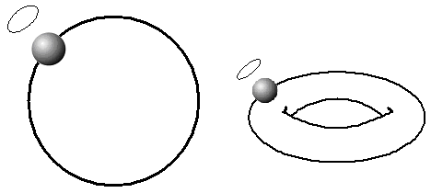
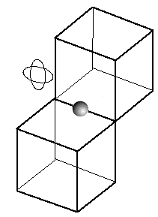
2 Manifold & Non-2 manifold objects
Geometric/PARAMETRIC Modeling
Solid Modeling
Perception of Solids
Modeling of Curves
Modeling of Surfaces (Patches)
Topology and Solids
Solid Modeling 1-2
Transformations and Projections 1-2
Representation, Differential Geometry
Ferguson Segments
Bezier Segments 1-2
B-spline curves 1-5
NURBS
Differential Geometry
Tensor Product
Boundary Interpolating
Composite
NURBS
manifold
Non-manifold
Notes:
<Read> paraphrase… Explain…

